Slide 1
Building an Accessible-First Component Library with Student Developers
Vladimir Jimenez
Senior Frontend Developer
Notes:
- who is comfortable with writing code or know coding concepts? I'd like to know if I should omit the coding parts.

Slide 2
Introduction: About Me
Currently @ UC Merced
Cosplayed as a software engineer @ Stack Overflow
4.5 years working in higher ed
17 years in open source
Mentored over 30 junior developers (since 2019)
Inadvertently experienced in refactoring and modernizing large or legacy code bases
Notes:
My experience has inadvertently made me an expert at refactoring and modernizing code bases with little down time.
Higher Ed: focus on introducing technology to a dated field
Stack Overflow: focused on refactoring their frontend (written in 2008 with jQuery 1)
Campuses traditionally use older technology; if it's not broken, why fix it?

Slide 3
Introduction: My work environment
My team consists of the following (2 🍕)
1 manager + project manager
1 tech lead + identity management
2 backend developers
1 frontend developer (me!)
3 student developers (frontend)
Projects my team maintains:
Account portal
Device registration portal
Admissions website
SSO integration with a form service (i.e., Hyland OnBase)
Campus directory
Notes:
2 pizza rule: teams should be small enough to feed with two pizzas; popularized by Jeff Bezos
3 more projects on the roadmap
Frontend == accessibility

Slide 4
My Challenges
Tech debt introduced by different vendors and former developers
Vendors don’t always take into account long-term planning and accessibility
Multiple projects are maintained in parallel
Each project has its own dependencies, organization, patterns, and language
Invest time to teach students how to work in ONE codebase
Not a problem for experienced developers to context switch, but harder to hire
Accessibility is rarely taught to developers, especially students
Too many full-stack developers not well-versed in accessibility
Too much to teach, too little time
Notes:
Prior to my getting hired, UC Merced made use of consulting agencies design and build their websites because that was the best approach forward at the time. then they decided to hire me and now this is my best approach forward to reign in all the projects to make working on them easier.
Vendors will build exactly what you want, in whatever language they want. this is a problem down the line because in my situation, I have 5 different projects using 5 different design/organization patterns, 5 different set of dependencies, and 2 different frameworks at 3 different versions.

Slide 5
Solution: Component Library + Companion Stylesheet
Use a monorepo
Components will focus on functionality and accessibility
Build your UI components once
Ensure proper HTML structure and ARIA attributes in these components
Keep your components separate from your stylesheets. Why separate?
Components can be tested with different stylesheets; e.g. different themes per website, test stylesheet v1.0.0 vs. v2.0.0, dark mode?
Stylesheet will force certain HTML structure; ideal for copywriters who just need HTML and CSS to copy onto their pages
This separation is nothing novel; think back to Bootstrap, React Bootstrap, ngBootstrap

Slide 6
Getting Started
Build your library one component at a time
Start the library with just one component; e.g.,
A button component
A visual "table" component
"Port" components from existing projects into your component library

Slide 7
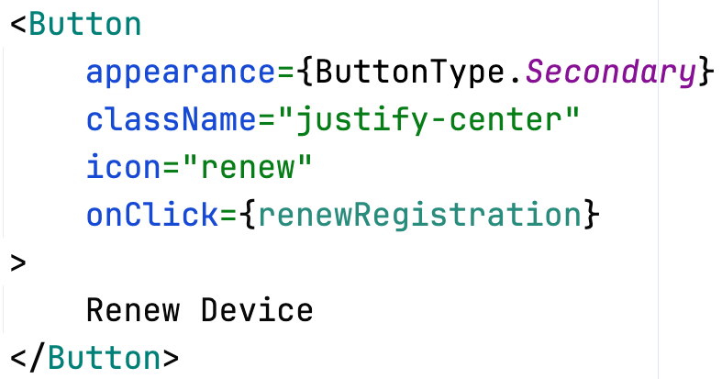



Our First Component: <Button />
Requirements
Loading state to stop duplicate submissions
Accessible icons
Screen reader accessible
Component Properties
Icon will render an accessible icon
TypeScript used to restrict the body of the tag to be just a string
onClick accepts Promises and automatically disables itself

Slide 8
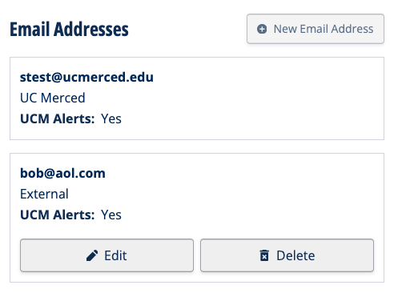
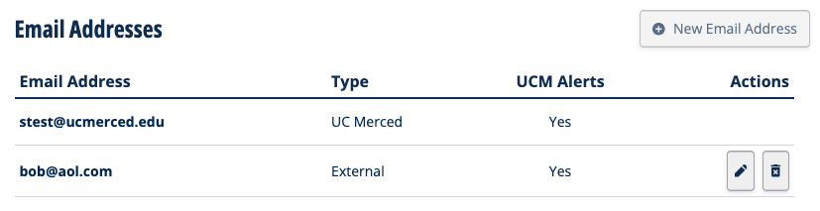
Let’s Make Things Difficult: A “Visual” Table
Mobile responsive "table"
HTML structure is vital for accessibility purposes

Slide 9
Why Build When You Can Buy?
Dependencies differ amongst projects; e.g.,
Account Portal uses Bootstrap v5.0
Campus Directory uses Bootstrap v2.0
I'm not saying to not use Bootstrap, use it as a dependency to your component library
Stack Overflow with Stacks
Google with Material UI
GitHub with Primer
Nothing proprietary, just aggregating your upgrade needs into one spot
Students will still get transferable job skills from this design

Slide 10
Getting Students Involved
"Students can't be trusted to write good code!"
Onboarding documentation: demo project
Project planning: Jira
Collaboration + code review: Git + GitHub
Component library documentation
Bug reports + feature requests
Here’s where accessibility development and learning happens!

Slide 11
Project Planning: Use a Template for Tickets
GitHub: <repository, issues, pull requests, docs, etc.>
Figma: <link to the Figma>
Include which layers are relevant to this ticket
API Spec: <link to OpenAPI spec, e.g.>
Development Libraries: <link to documentation for necessary libraries>
Image Preview: <include screenshots of prototypes, wireframes, mockups, bugs, etc.>
Requirement Specification: <bulleted list of what criteria should be met to be considered “done”>
References: <links to any PRs, source code files, websites, etc.>

Slide 12
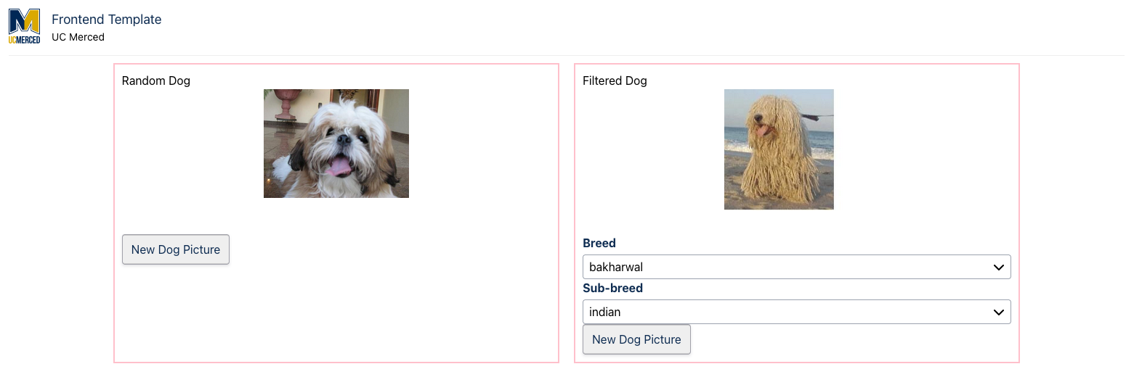
Starter Project
Dog-feed your own component library
Split up the project into Jira tickets
Submit via team’s code review workflow

Slide 13
Code Reviews
Don't blindly trust code. Period. Full stop.
Reminder: this is a learning experience for students
Correct any accessibility errors that they may make and explain in detail
Any feedback or explanations made in reviews can become documentation

Slide 14
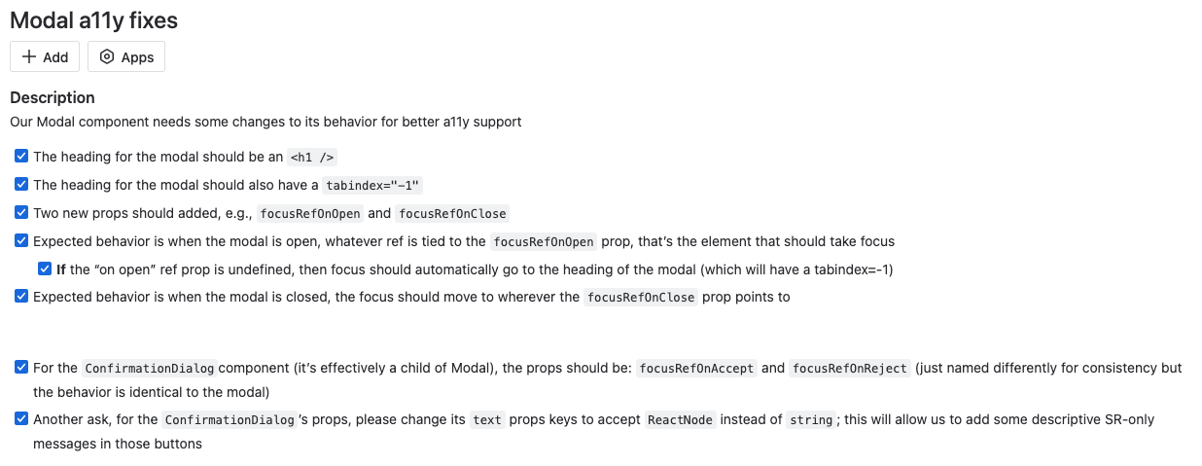
Publishing Changes
One a11y fix to the component library "trickles" down to dependent projects

Slide 15

Stay Tuned
UC Merced’s component library will…
Become open source soon
Will have a theme API
Ask your questions!
Follow UC Merced on GitHub: https://github.com/ucm-it
You can find Vlad here:
https://github.com/allejo
https://allejo.io/

